Slide 1
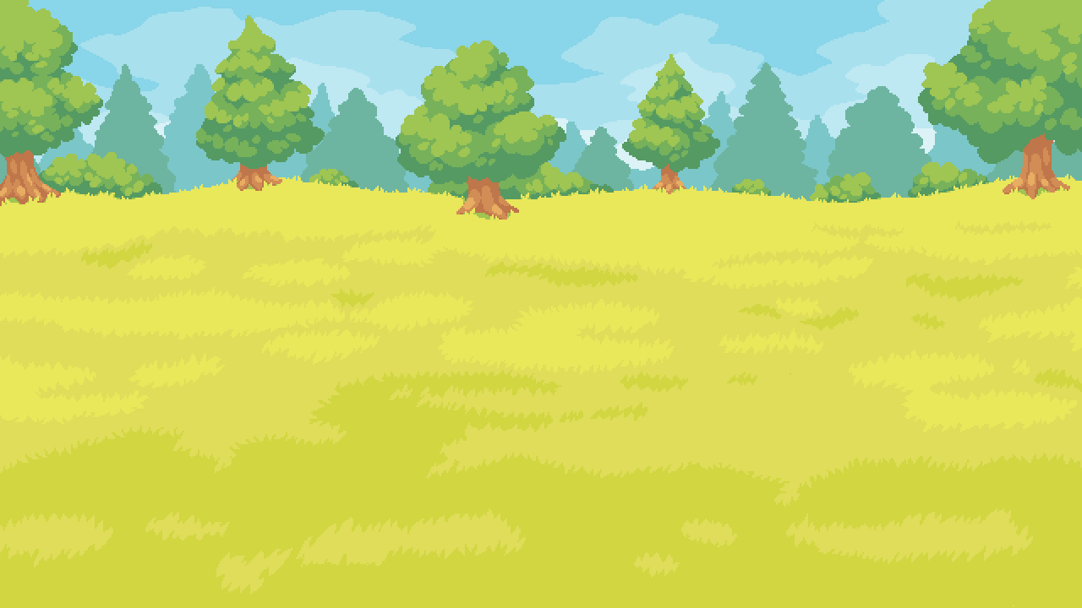

CARROTLY TOWN
Press to play!
AI powered NPC and Enviornment

Slide 2
Our solution
Player
NPC Anna
NPC John
Notes:
Sample players

Slide 3
Our solution
NPC Anna
Player
NPC John
Notes:
Knowledge base connected with each other

Slide 4


Our solution
asi1.ai
Knowledge Base

Slide 5
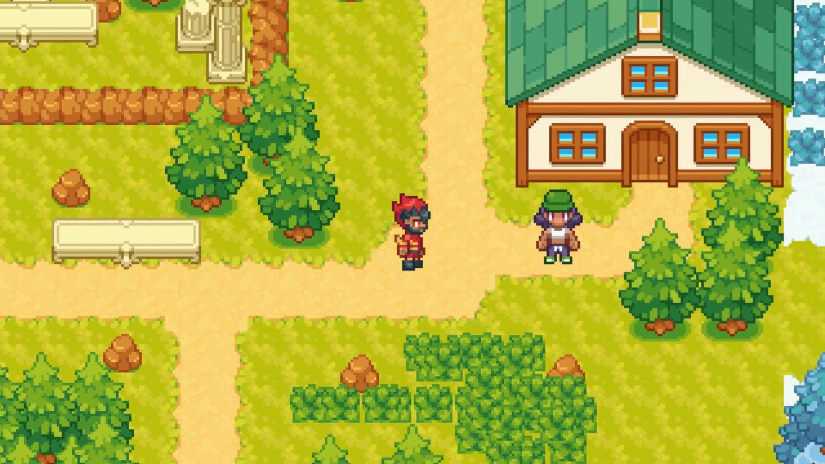

Make NPC aware!
Event interaction
Analyzed event with response and knowledge base update

Slide 6
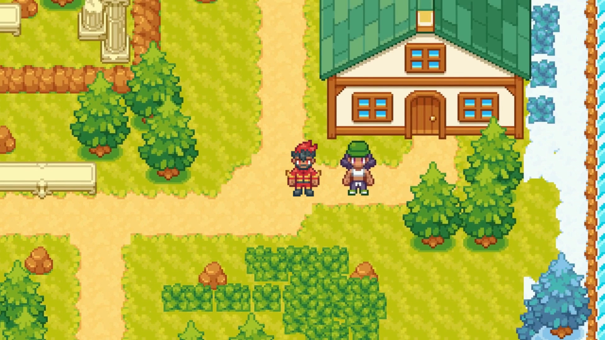
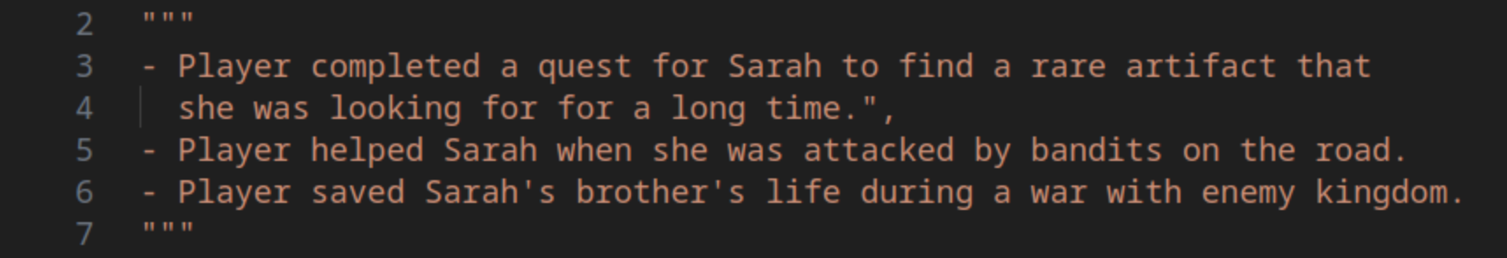
Make NPC aware!
Event interaction
Analyzed event with response and knowledge base update

Slide 7
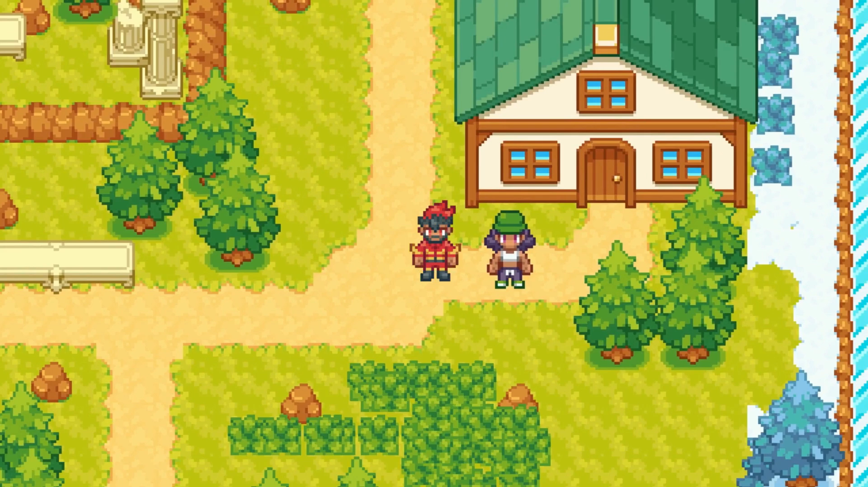
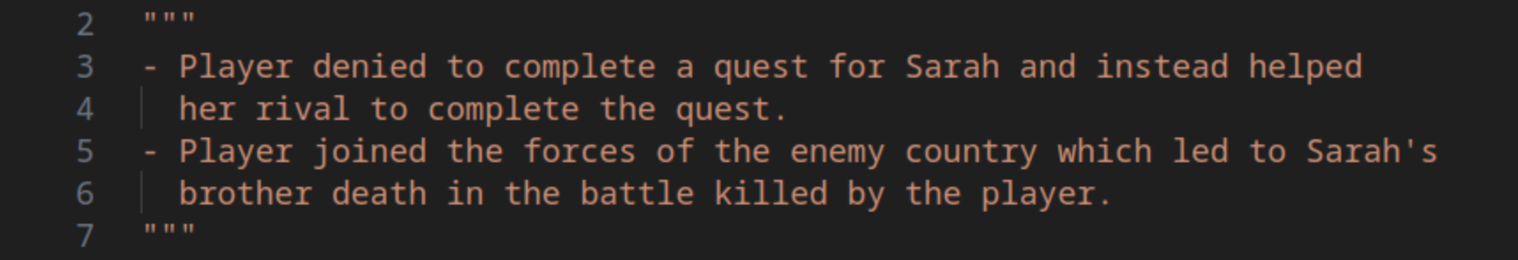
Make NPC aware!
Event interaction
Analyzed event with response and knowledge base update

Slide 8
Progressive Environment
asi1.ai
Player – NPC
Interaction Events
Environmental
Update

Slide 9
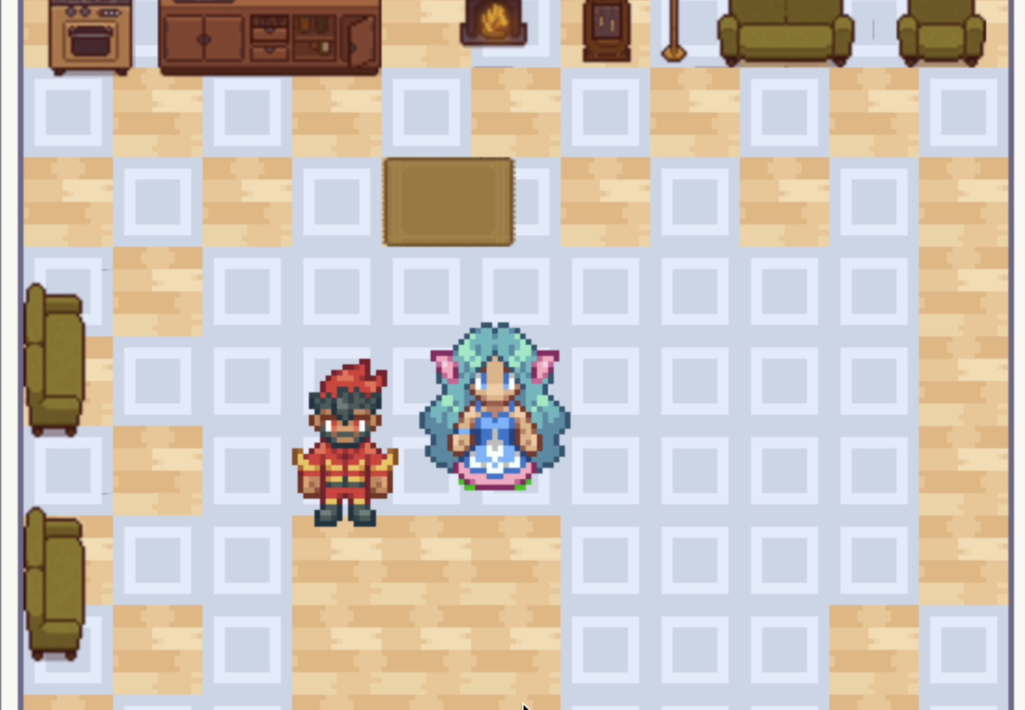
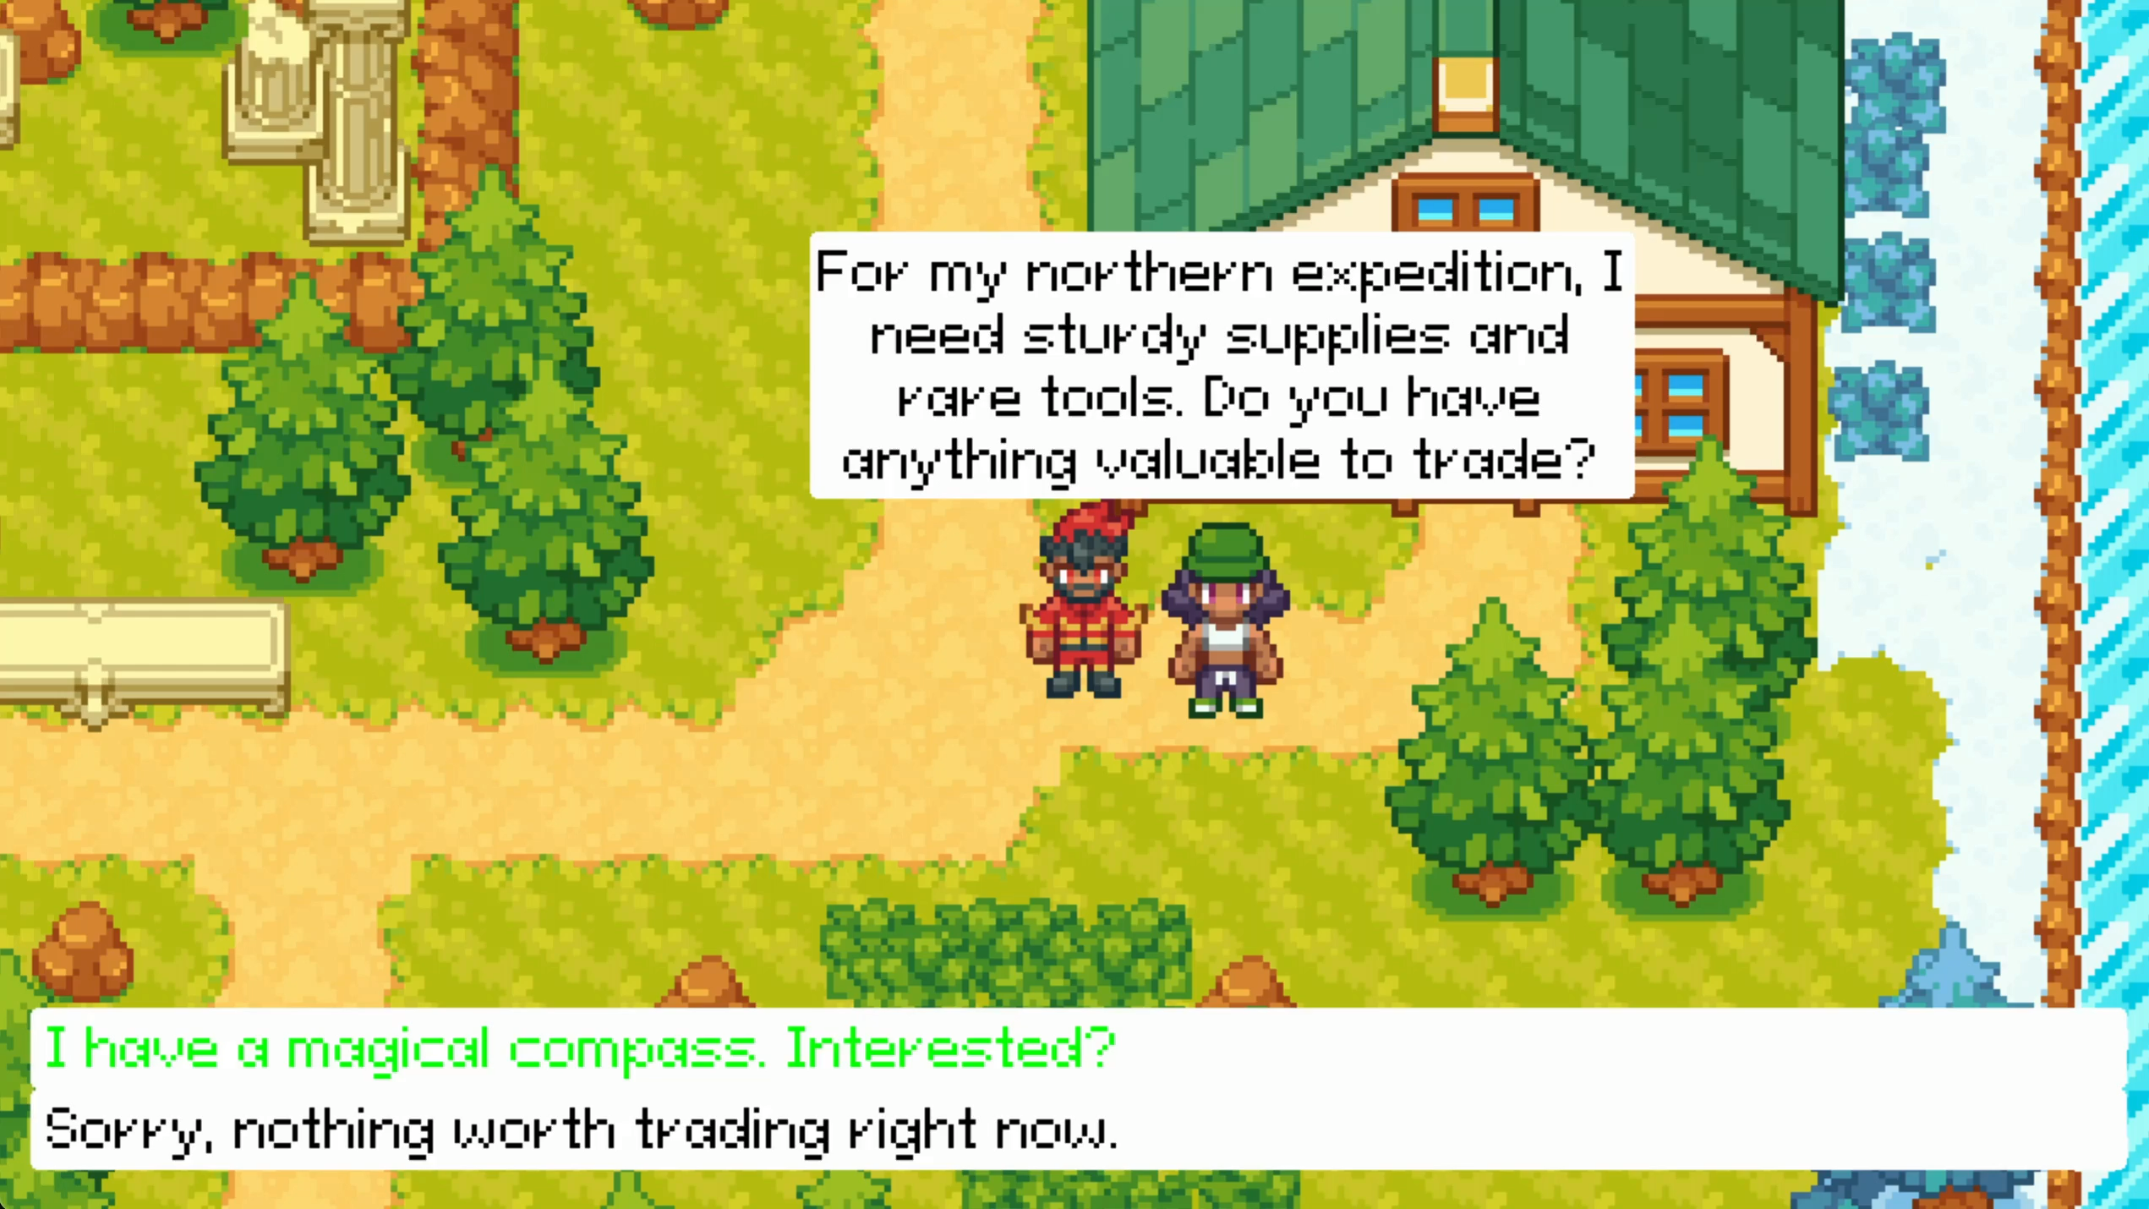
Progressive Environment

Slide 10
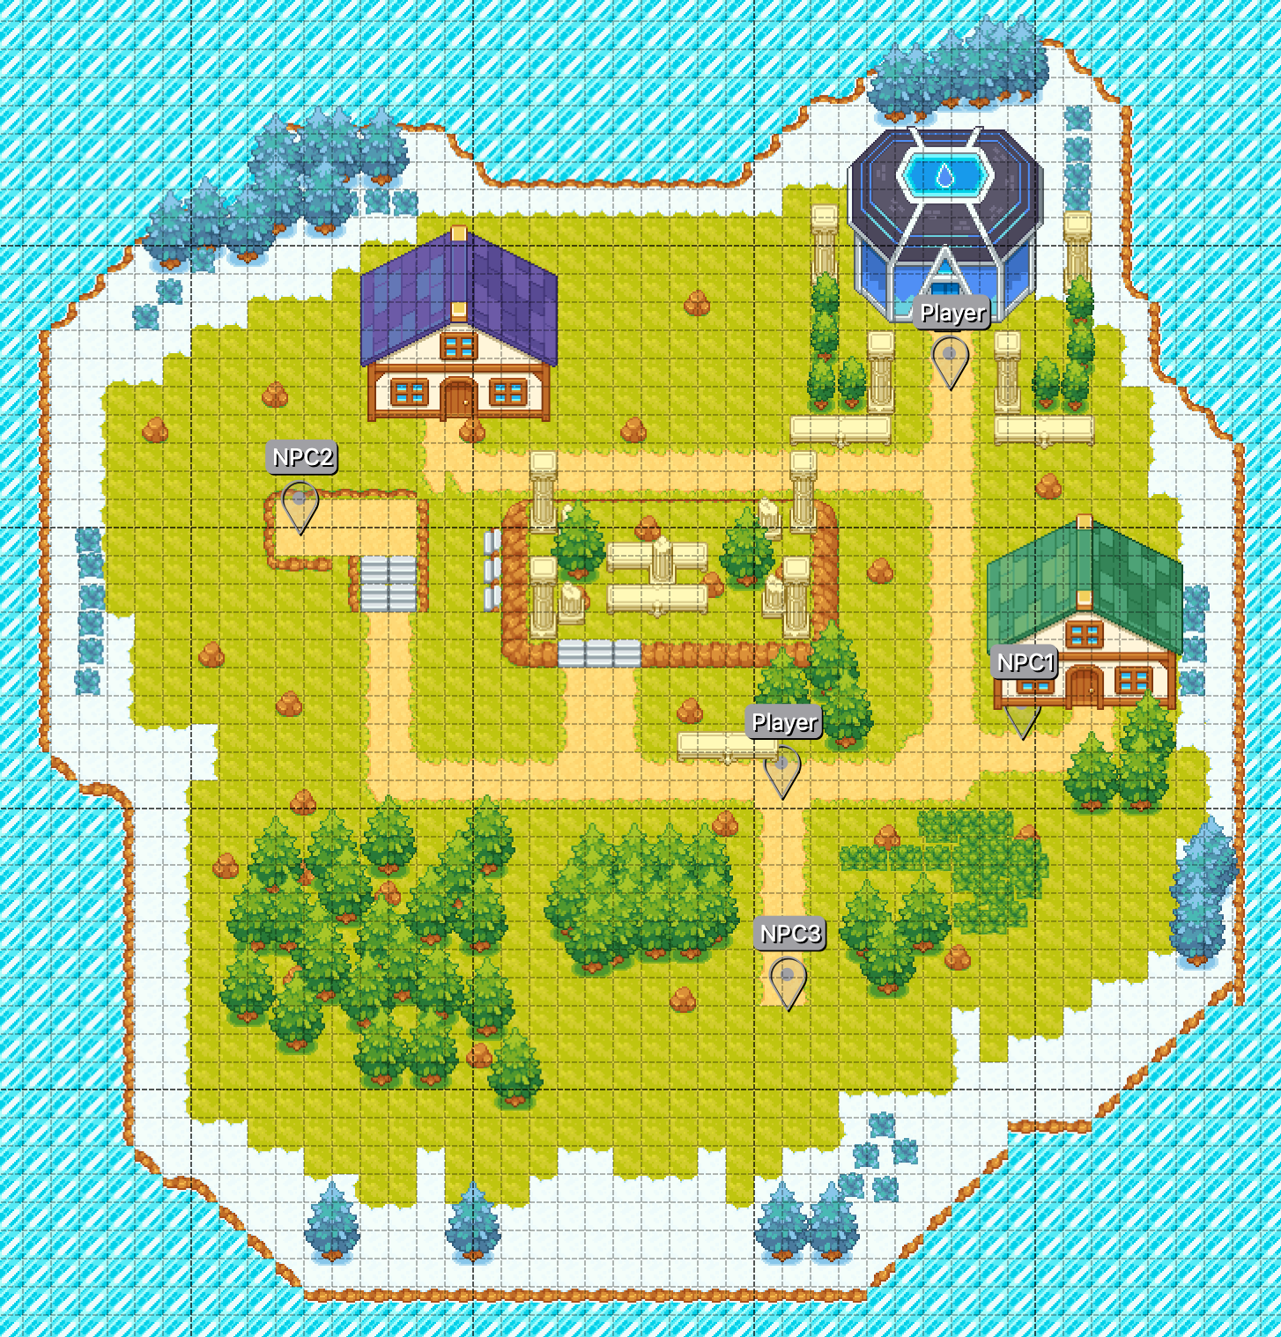
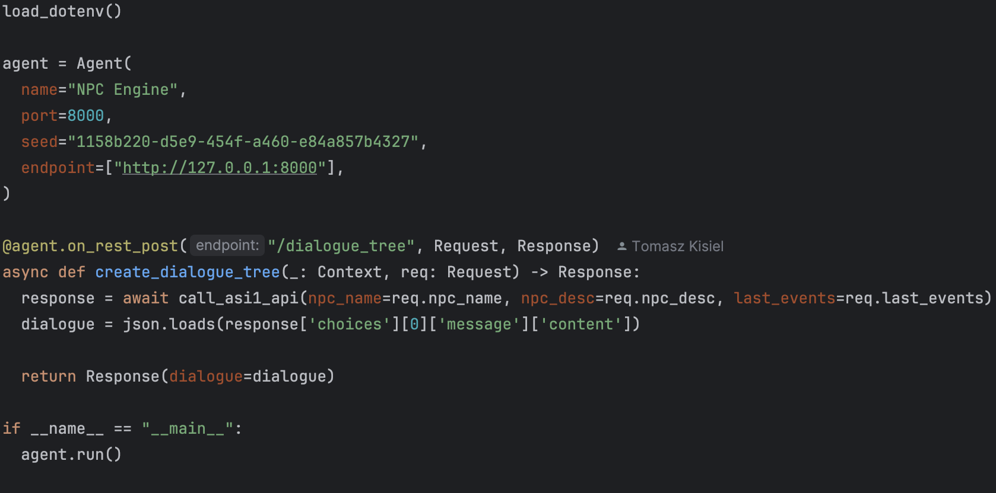
Two part solution
REST API
Intuitive setup
Fast integration
Ease of use
Notes:
Business model as a precusor to creating 2d vanilla NPC games and develop framework for others to use
No real and exsiting competition in production
What if stardev valley which already has amazing NPC system extended its logci by our solution?

Slide 11
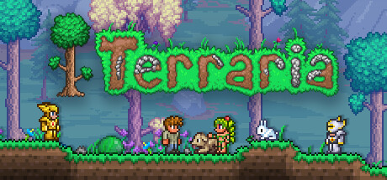
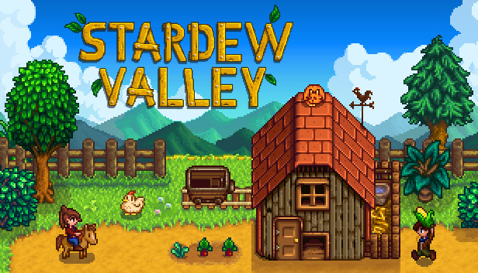
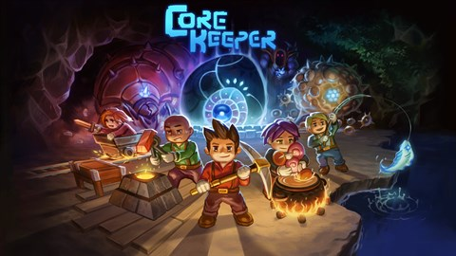
Extension to best games
Notes:
Business model as a precusor to creating 2d vanilla NPC games and develop framework for others to use
No real and exsiting competition in production
What if stardev valley which already has amazing NPC system extended its logci by our solution?

Slide 12
Future tune ups
Integration with streaming API
Graph database
Export to open sdk
Dynamic model definition
3D movement and behaviour incorporation
Inter agent communication

Slide 13
Thank You!
Press to exit!

